Slide 1
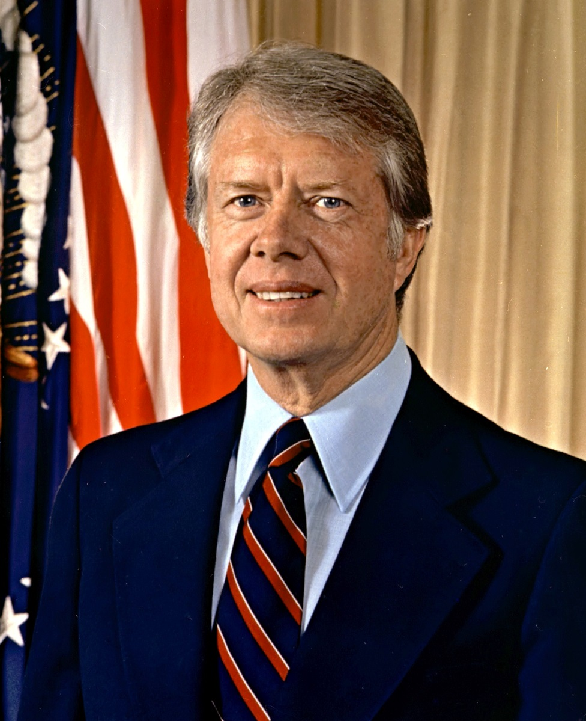
The Jimmy Carter years
Maria corr, Carolyn Kirshe, Katie O'Connor, vibha rao

Slide 2
A troubling time and a failure to respond
Both Gerald Ford and Jimmy Carter failed to effectively respond to the domestic and foreign crises of the 1970s.

Slide 3
background
Nixon’s presidency followed by distrust
Stagflation
Transition from manufacturing to service-based industries
American dependence on oil
Arab-Israeli War
Election of 1976

Slide 4
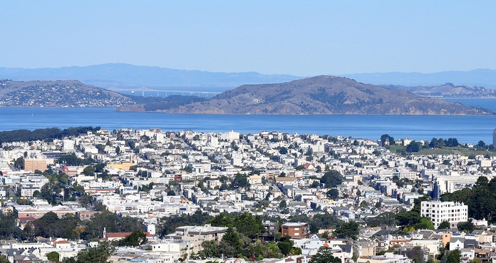
economic
Oil embargo
Energy Crisis
Decline in trade unions
Sunbelt & Snowbelt Communities
Silicon Valley
Minority groups

Slide 5
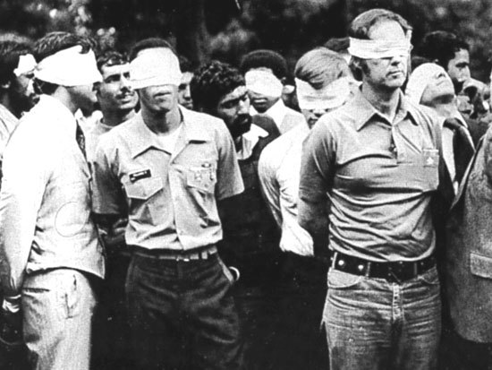
Foreign Policy
US & Iran relationship
Carter’s moral principles
Camp David Accords
Iran Hostage Crisis 1979

Slide 6
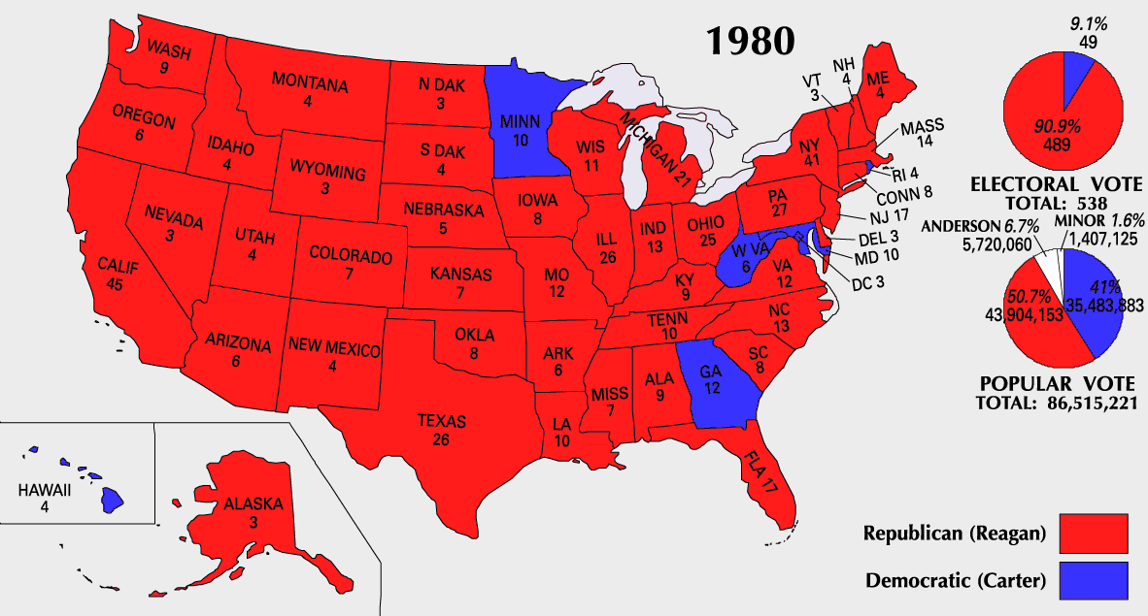
Domestic Policy & Outcome
Malaise Speech
Election of 1980
Rise of Reagan & Carter’s failures

Slide 7
trends
America’s dependency on oil
Shift from manufacturing to service industries
Increased distrust of America’s government and its leadership

